Slide 1
project2_restaurantapp
Objective: Learning Django Models, ORM and Forms Api

Slide 2
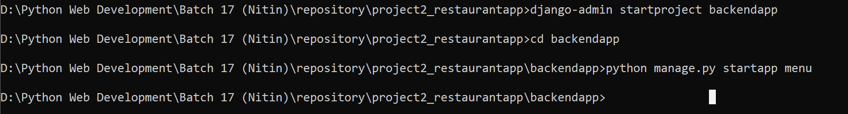
Step 1 : Create Project
Required Python Modules
django
pillow
pymysql

Slide 3
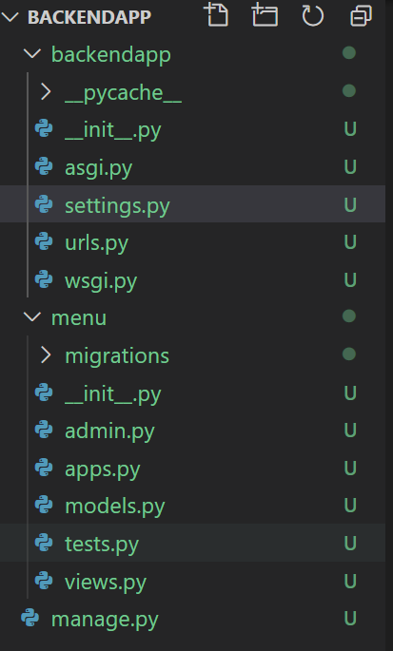
Step 2 : Project Structure

Slide 4
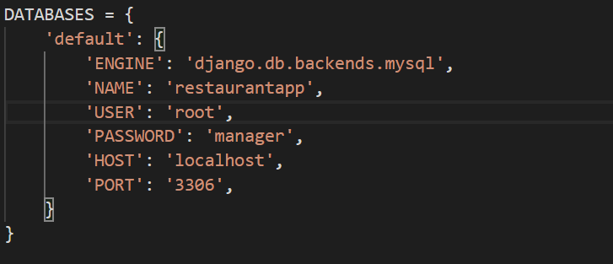
Step 3 : Database Settings

Slide 5
Step 4 : Django Models Documentation
Django Models Documentation : https://docs.djangoproject.com/en/3.0/ref/models/fields/

Slide 6
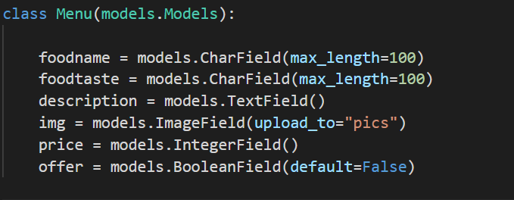
Step 5 : Create Model
Open models.py and create following class

Slide 7
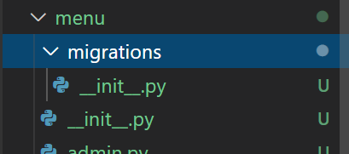
Step 6 : Check migrations directory
You can see only __init__.py before command makemigrations

Slide 8
Step 7 : Run Command makemigrations
Before execute command makemigrations be sure you added your app-name in settings.py -> INSTALLED_APPS

Slide 9
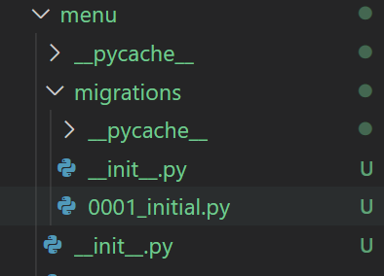
Step 8 : Check migrations directory
You can see now 0001.initial.py after command makemigrations

Slide 10
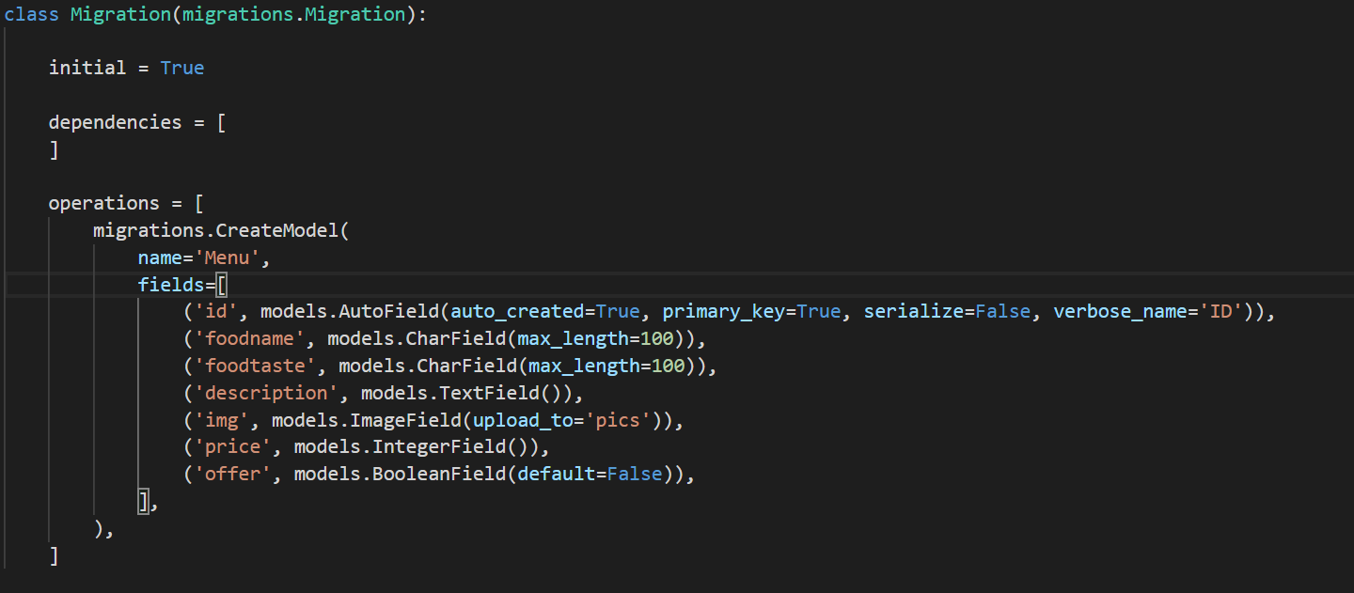
Step 9 : You are ready to migrate changes
Open the file 0001. initial.py which is generated code to create database tables after migrate command

Slide 11
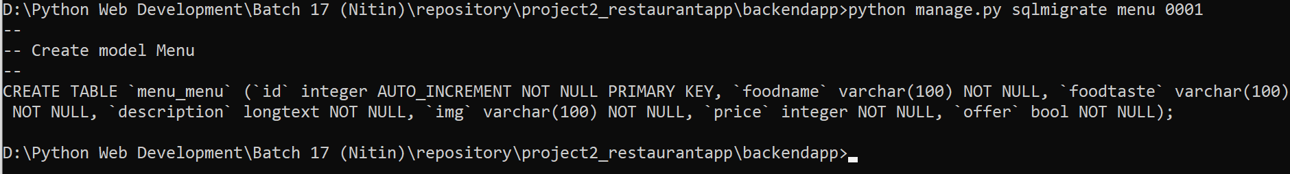
Step 10 : Run migrate command to confirm your code is ready

Slide 12
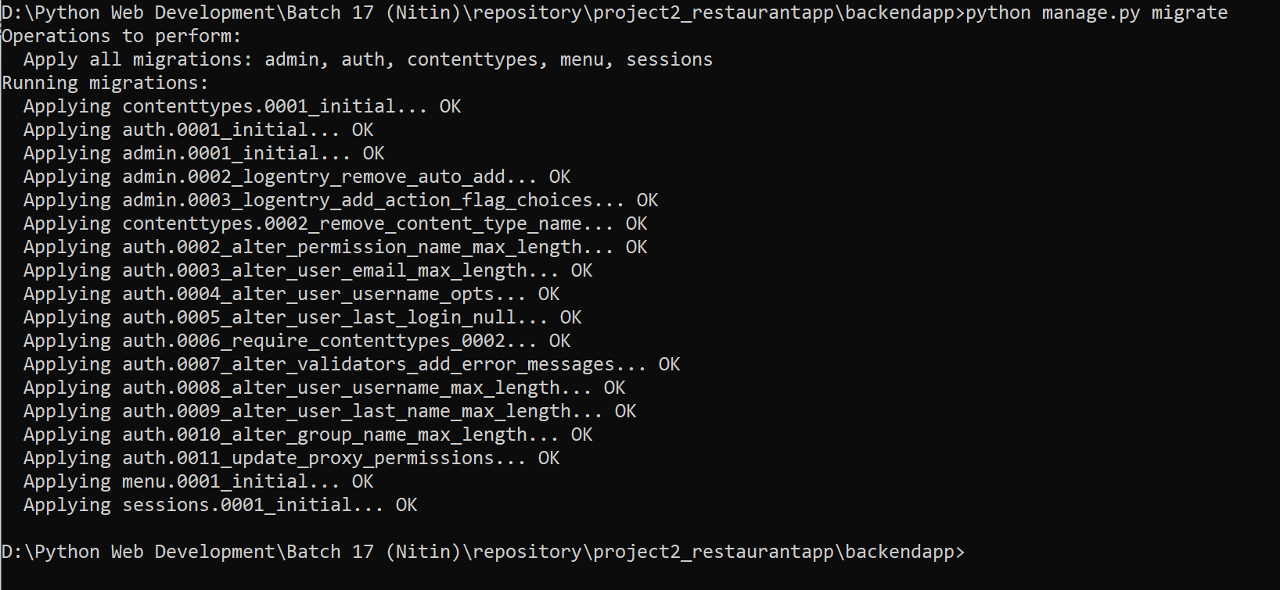
Step 11 : Final Step to complete migration is the following screenshot

Slide 13
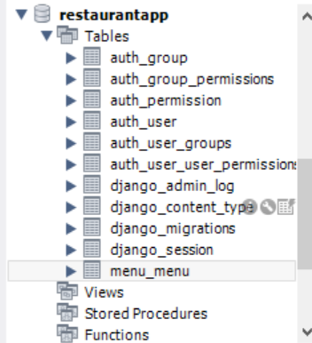
Open MySQL
Check Database Tables

Slide 14
Django Admin Panel
To manage administrative task

Slide 15
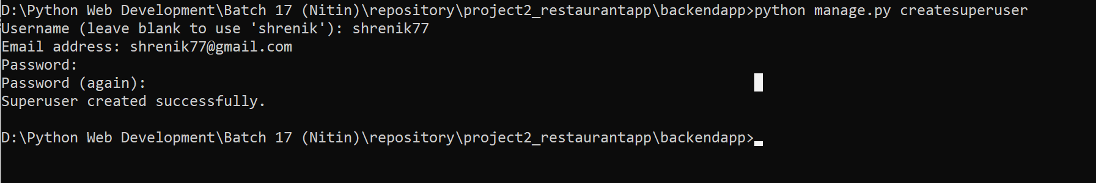
Step 1: Create User
Run command createsuperuser and then type username, email id, password

Slide 16
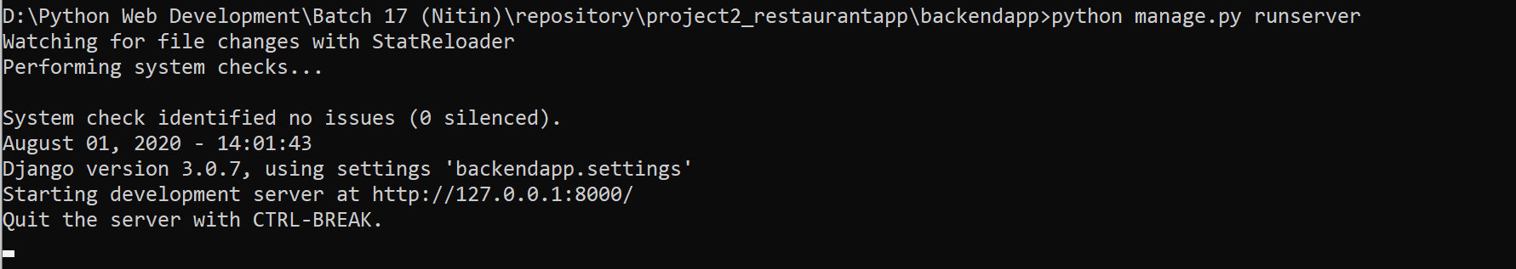
Step 2: Run Project
Command : python manage.py runserver

Slide 17
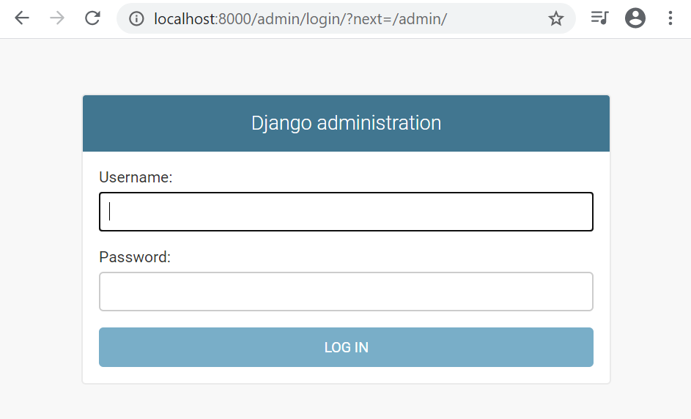
Step 3: Open admin panel

Slide 18
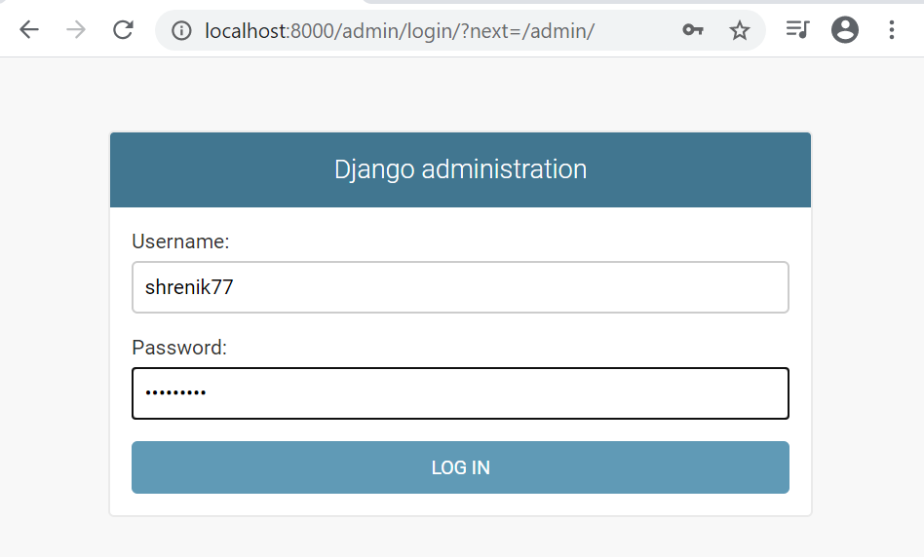
Step 4: Type Username and Password to Login

Slide 19
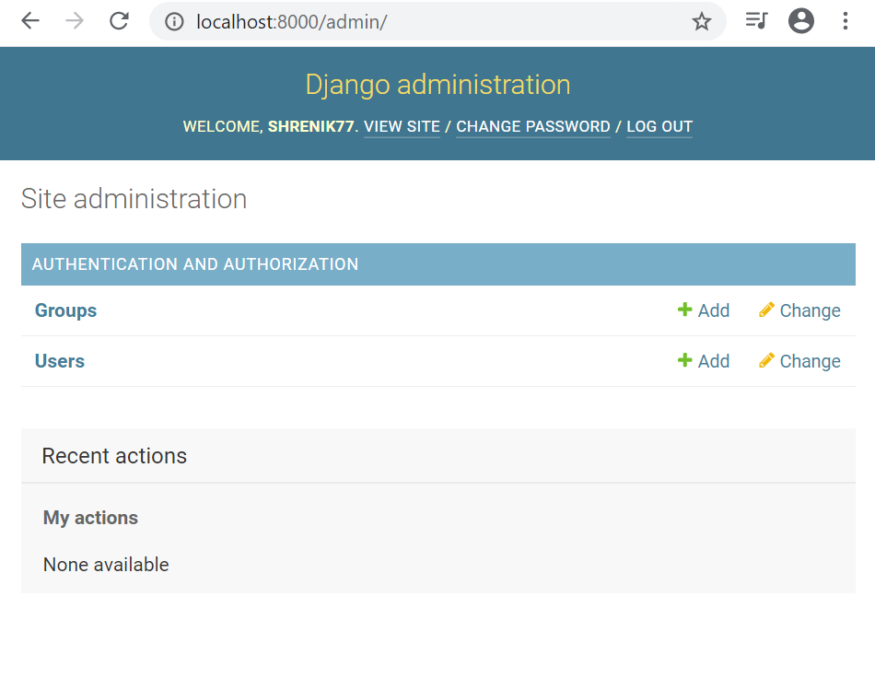
After Login

Slide 20
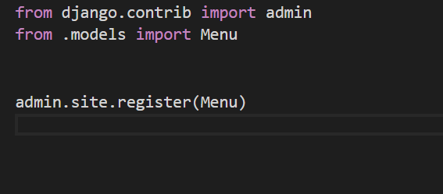
Step 5: Open admin.py file and register Model
This creates User Interface Form in admin dashboard from where you can insert, update and delete menus

Slide 21
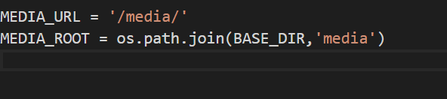
Step 6: Open settings.py file and add media urls
To store image files add following two lines

